Slide 1
IRES IRB Changes for Researchers and Staff
Research under External IRB Purview
To begin voiceover, click on this symbol at the bottom, next to zoom function
Human Research Protection Program
Version 1.0
Effective Date: August 9, 2021

Slide 2
Training Agenda
Item | Slide #
Navigation | 4
Screen Specific Updates | 11
Workflow | 23
Study Updates | 28
First action on protocols after the upgrade | 37
https://mpclkyalestage6.huronclick.com/Training

Slide 3
Overall changes
Change Type | Summary
Navigation | Dashboard vs. My Inbox Shortcuts to Library, Help Center, IRB Submissions, IRB Reports moved from Menu to top screen Consolidated ‘Create New Study’ and ‘Create RNI’ Revised feel and look Added menu for screens to study level navigation
Screens | Added/removed questions on screens Enhanced Yale specific pages
Process | Updating study records with first CR Updating study records via updates

Slide 4
Navigation

Slide 5
My Inbox = Dashboard
Inbox

Slide 6
IRB Navigation

Slide 7
Study Workspace

Slide 8
Navigation – CR/MOD/MODCR
Clicking on the two arrows sign in MOD or CR workspace will show the breadcrumb to take you back to main study

Slide 9
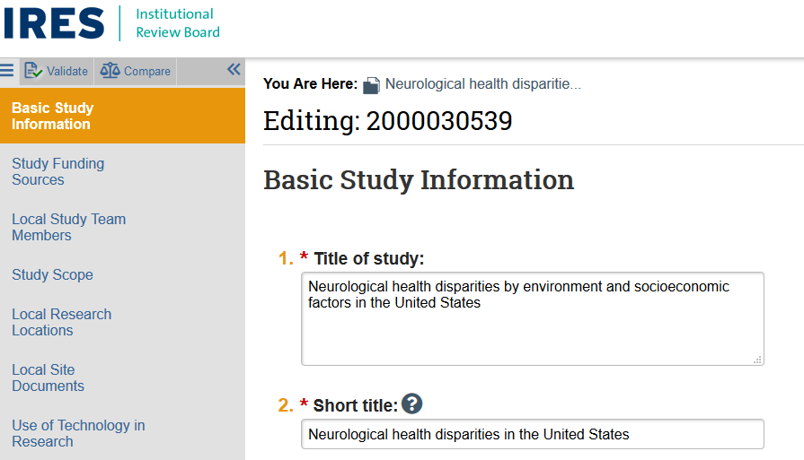
Study Navigation – ‘Edit Study’
No ‘Jump to’ button, instead, the study pages appear on the left

Slide 10
Page Navigation

Slide 11
Screen Changes

Slide 12
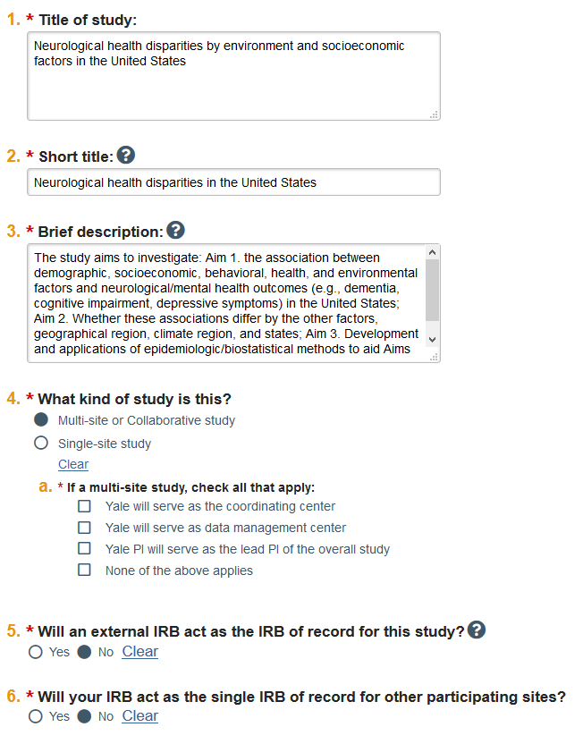
Basic Information
REVISIONS
Removed question # 7 Added question about type of study (#4) Minor wording changes in questions

Slide 13
Basic Information
Does not require entry unless the Yale PI also serves as the PI of the overall research.

Slide 14
Basic Local Site Information

Slide 16
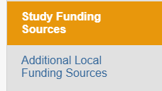
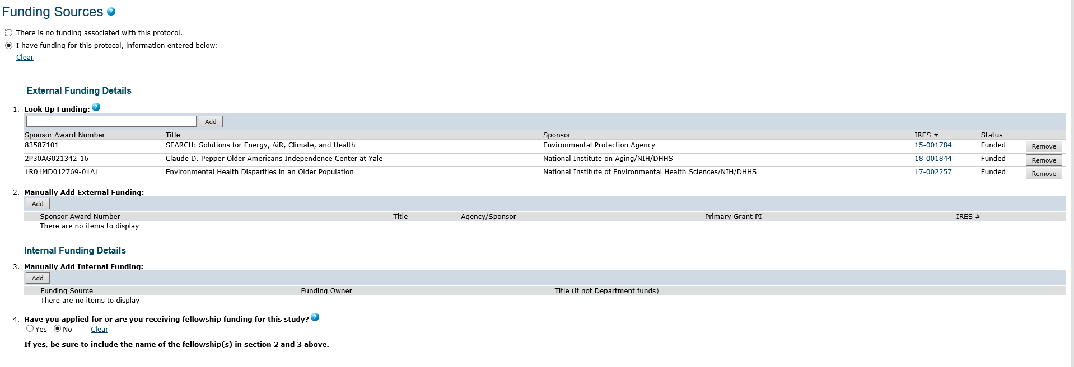
Funding Source
REVISIONS
Removed question # 4
There are two entries for funding sources. Use only Study Funding Sources.

Slide 17
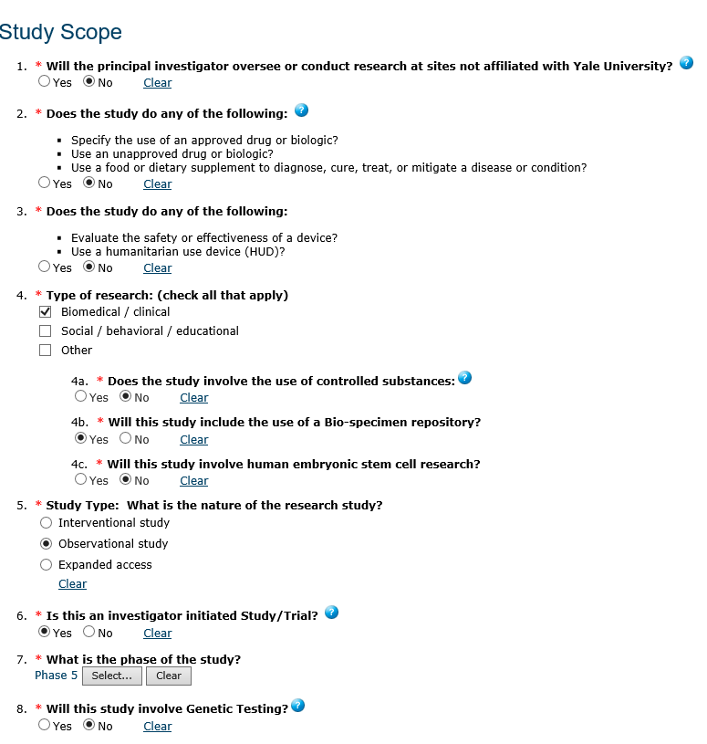
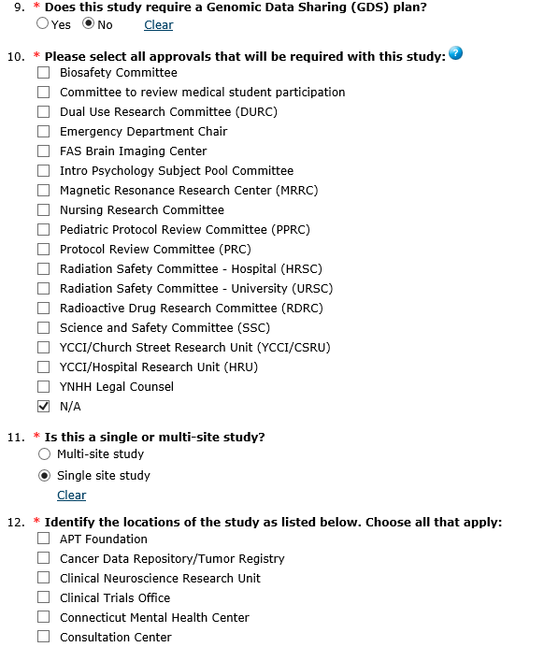
Study Scope: Questions Removed

Slide 18
Study Scope: Questions Added

Slide 19
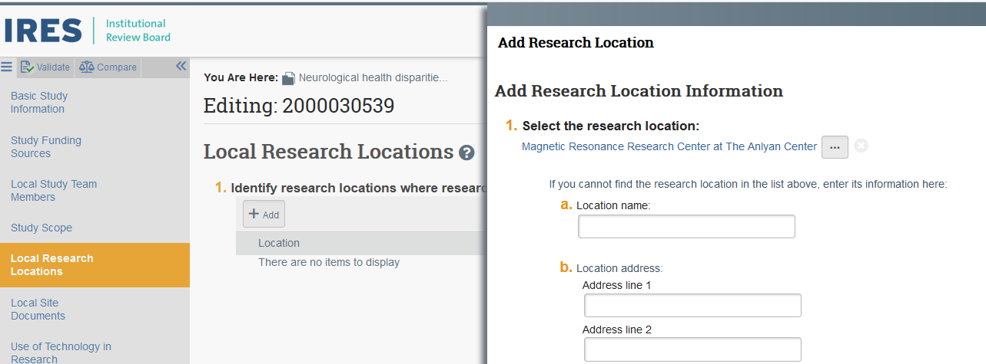
Local Research Locations
Many pre-populated research locations at Yale available for selection, including all Smilow Hospital Care Centers

Slide 20
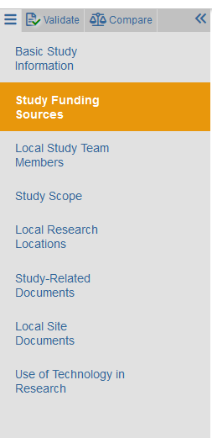
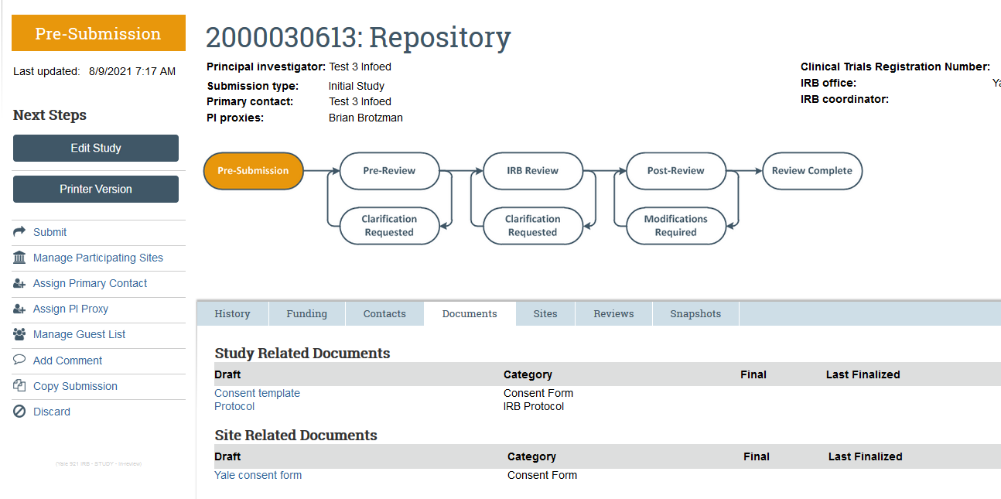
Study vs. local documents for multisite research
Sponsor templates
Yale versions

Slide 21
Consent Forms and Recruitment Materials & Supporting Documents Page
REVISIONS
Name of the screen was revised from ‘Consent Forms and Recruitment Materials ’ to ‘Local Site Documents’ Page now includes selection from Supporting Documents page

Slide 22
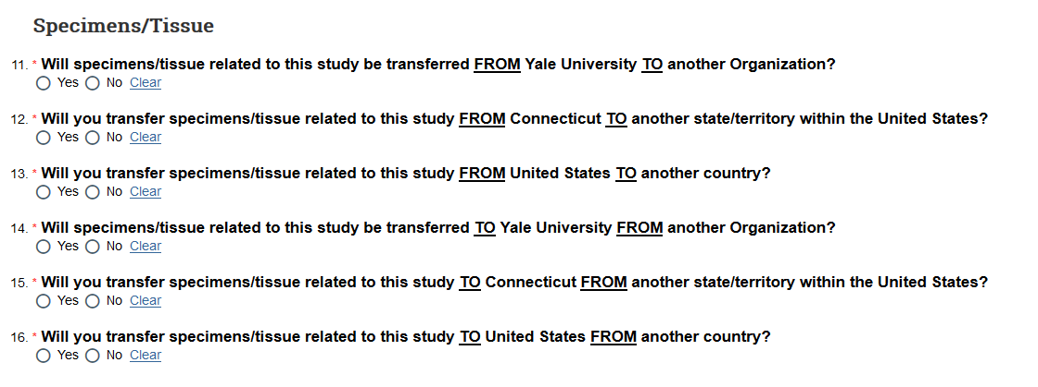
Use of Technology in Research
REVISIONS
Added section about Specimens and Tissue Minor reorganization on question on the page

Slide 23
Workflow

Slide 24
Workflow
Current Process:
Authorization Letter
Revised Process:
Authorization Letter

Slide 25
Study with Authorization to Use External IRB
Authorization Letter

Slide 26
Submitting initial approval letter

Slide 27
Acknowledgment of the IRB Approval
Acknowledgment Letter

Slide 28
Study Updates

Slide 29
Two types of study updates
Basic Information
External IRB
Funding Source
Study Scope
Study Documents
Basic Local Site Information (including PI)
Study Team Members
Local Research Locations
Local Site Documents
Use of Technology in Research

Slide 30
Study Details: Funding Source

Slide 31
Updating Study Details: Explain the change

Slide 32
Step1: Add A Comment to Notify HRPP

Slide 33
Step 2: Finalize Study Updates

Slide 34
Two types of study updates
Basic Local Site Information (including PI)
Study Team Member
Local Research Locations
Local Site Documents
Use of Technology in Research

Slide 35
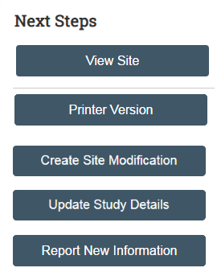
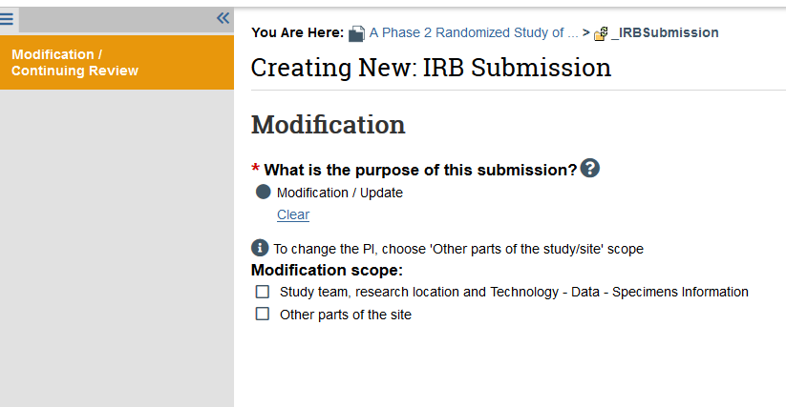
Updating Continuing Review dates

Slide 36
Updating Continuing Review Dates

Slide 37
First Actions on Existing Protocols After Upgrade

Slide 38
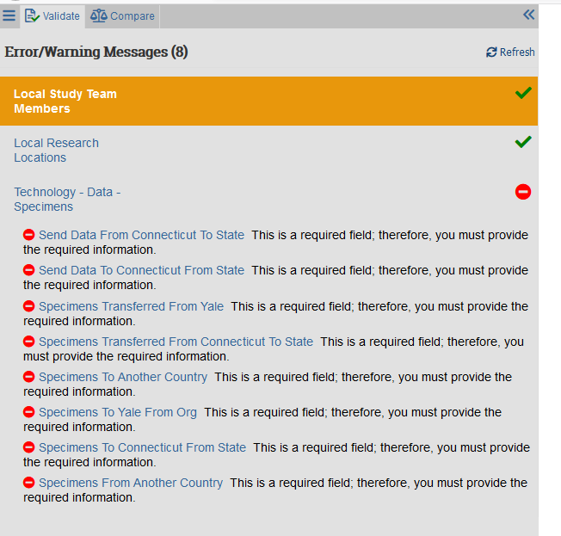
‘Validate’ to view missing information
Use Validate before submitting Initial requests and Site Modifications (that include Technology-Data-Specimens information).
Any time - update the Study Scope questions regarding repositories using Update Study Details.

Slide 39
Verify that information is correct
Verify that locations in the Local Research Locations is accurate.
For existing and approved research – do not move documents (e.g., from Local Site to Study-Related Documents). We want to preserve the history of the revisions to these documents.

Slide 40
Questions
Contact IRB Support: irb.support@yale.edu
Contact HRPP : hrpp@yale.edu

