Slide 1
Introduction to the Human Research Protection Program and the Yale IRBs
September 2015

Slide 2
HRPP make up
Research Requiring Review by an IRB
Protocol Submission Process – HIC and HSC
Collaboration with unaffiliated investigators
Where to get help

Slide 3
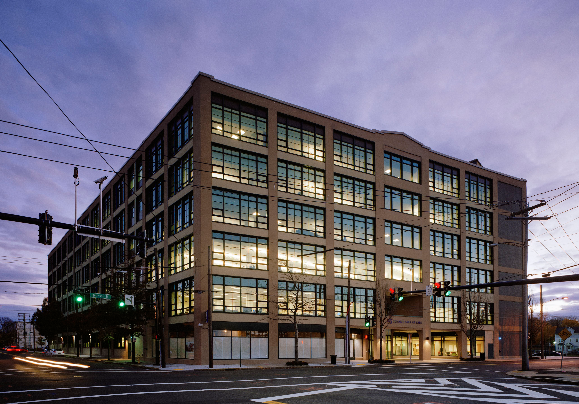
New Location
25 Science Park
3rd Floor
By appointment – 55 College Street or the investigator’s office
Phone numbers remain the same!

Slide 4
Yale Human Research Protection Program (HRPP)
Compliance
IRB
Billing
Education
Social, Behavioral, Educational Biomedical
(Human Subjects Committee) (Human Investigation Committee)
HSC HIC I/Ia HIC II HIC III HIC IV
3xRA 3xRA 2xRA 2xRA 2xRA
RA – Regulatory Analyst

Slide 5
HRPP Research Quality Assurance & Compliance (RQA&C) [aka the “HRPP Compliance Team”]
The role of the HRPP Compliance Team is to assist investigators in their efforts to ensure the safety of human subjects and the integrity of the research performed at Yale.
This is accomplished by partnering with the IRB (HICs and HSC), senior leadership and investigative community at Yale to continually improve upon the quality of research.
HRPP Compliance Team:
Jeri Barney, J.D., M.S., Senior Compliance Manager
Jessica Randall, M.A., CIP, Compliance Manager
Kimber Tanaka, Compliance Associate

Slide 6
HRPP RQA&C
Conducts reviews of and responds to:
concerns of potentially serious and/or continuing noncompliance (deviations)
potentially serious concerns expressed by subjects or non-subjects
unanticipated problems involving risk to subjects or others (UPIRSOs) that result in changes to the protocol or consent made at the request of the Yale PI or Yale IRB
Study suspensions and/or terminations
Activities of RQA&C include, but are not limited to:
Conducting Not-For-Cause (NFC) reviews of human subjects research (HSR) studies conducted at Yale & approved by the Yale IRB [or external IRB] to assess compliance with University policies, procedures and federal regulations
Conducting For-Cause (FC) reviews of HSR studies in response to concerns of potentially serious and/or continuing noncompliance (deviations)
Reviewing UPIRSOs (when appropriate)
Reporting noncompliance to Federal agencies (when appropriate)
Assisting the research community in preparing for and responding to external audits (including FDA inspections)

Slide 7
Billing
IRB charges fees for review of industry sponsored research studies.
The IRB fee schedule is available on the website.
Meriam Worzella, IRB Billing & Affiliate Agreements Manager

Slide 8
Education
First and Second Friday Series
Monthly sessions in Cohen Auditorium
Per Request Training Sessions for individual groups
Consultations
Online resources
Monika Lau, Education, Training & IRB of Record Specialist

Slide 9
Institutional Review Boards - IRB

Slide 10
Human Investigation Committee
HIC I (Oncology)
Christine Earley
Dawn Pedevillano
HIC II (Psychiatry)
Jennifer Reese
Stacey Scirocco
HIC III (Internal Medicine)
Ellen Bedard
Jennifer Eagan
HIC IV (Pediatrics)
Michelle Antisdel
Lisa Esposito
Senior IRB Protocol Specialist
Amy Blakeslee

Slide 11
Human Subjects Committee
Carrie McDaniel
Brandy Dionne
Cheryl Danton

Slide 12
IRB Chairs
HIC I
John D. Roberts
Maurice J. Mahoney
Vice - Madelon Baranoski
HIC II
Sandra Alfano
Vice: Suchitra Krishnan-Sarin
HIC III
Maurice Mahoney
Vice: Madelon Baranoski
HIC IV
Sandra Alfano
Vice: Suchitra Krishnan-Sarin
HSC
Stephen Latham
Vice: Madelon Baranoski

Slide 13
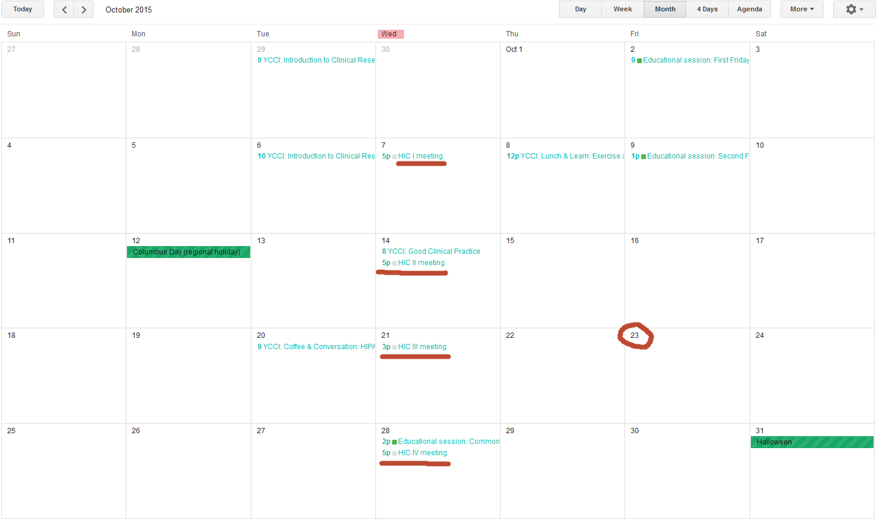
HIC Meetings

Slide 14
Numbers
2014:
Initial Approvals: 556 (does not include exemptions)
Renewals: 1194
Amendment: 1474

Slide 15
If your project falls into the category of Research Involving Human Subjects, IRB review is required.

Slide 16
IRB Decision Tree
Is it Research?
NO
IRB Review is not required
YES
Does It Involve Human Subjects?
NO
IRB Review is not required
YES
Does it meet any of the exemption categories?
IRB Review and Approval are required
NO
YES
Exemption determination is needed

Slide 17
Research 45CFR46.102
Research means a systematic investigation, including research development, testing and evaluation, designed to develop or contribute to generalizable knowledge.

Slide 18
Projects that are not research
Quality Improvement (QI) and Quality Assurance (QA) projects are designed to improve clinical care, patient safety, health care operations, services and programs or for developing new programs or services (e.g., teaching evaluations, patient/employee service surveys).
QI/QA is generally NOT generalizable, and is meant to be applicable to a particular setting.
Case Study

Slide 19
Human Subjects 45CFR46.102
Human subject means a living individual about whom an investigator (whether professional or student) conducting research obtains
(1) Data through intervention or interaction with the individual, or
(2) Identifiable private information.

Slide 20
Data that would NOT be considered Human Subjects
Data about health facilities, businesses or organizations that are not individuals
Data on deceased persons
Deidentified human data or specimens

Slide 21
Exemptions
A federally designated category
Describes certain kinds of minimal risk research
Minimal Risk: probability and magnitude of harm or discomfort anticipated in the research are not greater in and of themselves than those ordinarily encountered in daily life or during performance of routine physical or psychological exams or tests.
Means that the research is determined to be exempt from continuing IRB review

Slide 22
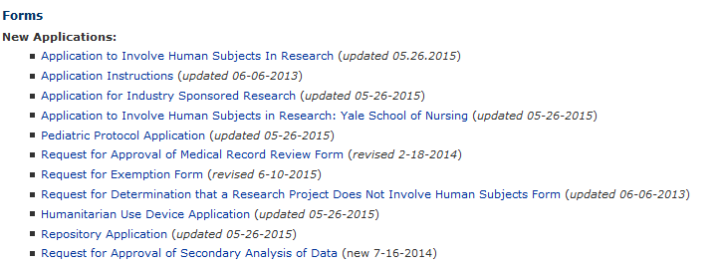
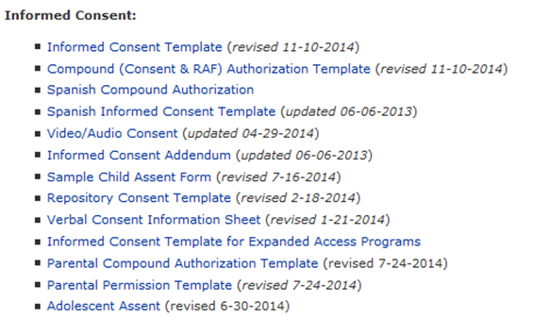
Documents needed for the IRB Review
Exemption Request or full Protocol Application
Consent document OR consent script
(for verbal consent)
Surveys, measures, etc.
Recruitment materials
Sponsor documents

Slide 23
Points to remember when developing a research protocol/ consent documents
Describe in detail what it is that you are doing and why
Describe your subjects and how you are recruiting them
Include the description of consenting process
Describe risks and benefits of the study
Answer all the questions in the forms
Include all survey questions or possible topics of discussion when needed
Include all required consent elements – use the template
Make sure you and your faculty advisor have completed human subject protection training and conflict of interest disclosure

Slide 24
Approval Criteria 45CFR46.111
Risk to subjects are minimized
Risks to subjects are reasonable in relation to anticipated benefits
Selection of subjects is equitable
Appropriate informed consent
Appropriate documentation of informed consent
Data collection is monitored to ensure subject safety
Privacy/Confidentiality is protected
Additional Safeguards for vulnerable populations

Slide 25
Important links before you submit the application
Human Subject Protection Training:
http://learn.med.yale.edu/irbtraining/
COI Office for conflict of interest disclosure:
http://coioffice.yale.edu/
Templates and Forms:
http://www.yale.edu/hrpp/forms-templates/biomedical.html

Slide 26
Submission to the IRB
Human Subjects Committee – the IRB for social, behavioral and educational research : human.subjects@yale.edu
Human Investigation Committee – the IRB for biomedical research: hic.submissions@yale.edu

Slide 27
Protocol Submission
Human.subjects@yale.edu
Regulatory Analyst
Triage
Regulatory Review for Initial Submissions
Expedited Review Full Committee
Administrative Assistant
Initial checks/Data Entry
Submissions via email
- HSC

Slide 28
Points to Remember about HSC process
HSC meetings are scheduled on semester by semester basis – will be set soon and posted on the website/calendar
Some of the submission forms are different – they are posted in a different place on the HRPP website
Does not Require Submission Cover Sheet (a requirement for HIC submissions)

Slide 29
To ensure a quicker review and turnaround time:
Always start with current forms on SBE Forms and Templates page
Protocol application or
Exemption application
Consent form or
Verbal consent script (mainly used for exemptions)
Ensure all training and COI disclosures are complete.
Human Subject protection training (All investigators, study personnel and faculty advisors)
HIPAA training if applicable (All investigators, study personnel and faculty advisors)
Conflict of Interest Disclosure form (PI, faculty advisor, co-investigators)
Ensure all documents required are completed and submitted
Protocol application or Exemption application
Consent form or verbal consent script
Questionnaires, surveys, assessments, interview questions, etc
Recruitment materials (advertisements, fliers, website ad scripts)

Slide 30
Protocol Submission
hic.submissions@yale.edu
Administrative Assistants
Initial checks/Data entry into the system
HIC Team
Triage
Regulatory Review for Initial Submissions
Expedited Review Full Committee
Submissions via email
- HIC

Slide 31
Initial Checks
Signatures of the Principal Investigator, faculty sponsor (if needed), and the Department Chairperson
COI and Training for the PI
Submission cover sheet
Other actions pending

Slide 32
Triage
This is where the determination between Full Committee Review and Expedited Review is made.
Expedited review is determined by Federal regulations, not the HIC.

Slide 33
Regulatory Review
New protocols submitted to the HIC are assigned to a team and then to one of the team’s regulatory analysts (RA), who will review the submission for clarity, completeness, and regulatory compliance.
This RA will work with the PI or research coordinator to create a version of the protocol that is ready for submission to the Full Committee or for expedited review.
Regulatory Review may take 2 to 4 weeks

Slide 35
Expedited Review
This means that the research falls into one of the federally allowable expedited review criteria.
The protocol can be reviewed by an HIC regulatory analyst and does not have to go to full committee for review

Slide 36
Federal Regulations regarding expedited review
Federal Regulations allow for expedited review when:
Research presents no more than minimal risk
The research fits specified categories
The identification of subjects (or their responses) would not place them at risk of criminal or civil liability, be damaging to their financial standing or reputation, be stigmatizing (unless there are appropriate protections in place for guarding this)

Slide 37
Expedited Review
When a protocol is being reviewed as “expedited”, communication between the RA and protocol correspondent is usually via e-mail or phone call.
This communication will notify the correspondent as to whether the protocol is approved or requires specific minor revisions.

Slide 38
Full Committee Meeting
Committees meet every Wednesday of the month -three evenings and one afternoon- and HIC I also meets one Friday morning per month.
Each protocol is discussed and voted on.
Any revisions requested are conveyed to the PI via letter, usually within 2 days of the meeting
Approvals are also typically ready within 2 days with all the appropriate documents validated.
Notes:
Now 4 committees
This could be delayed depending on the volume of the agenda for that meeting or if we are waiting for information from the PI.

Slide 39
What the Committee Can Do
Approve the study for a period no longer than a year
Ask for Specific Minor Revisions
Ask for Substantive Revisions (Deferral)

Slide 40
Changes
If during the course of the study you realize a change is needed, you have to submit an AMENDMENT for review and approval
Do not implement changes without the IRB approval
Changes which do NOT affect the exemption status you were granted do not have to be formally reviewed by the IRB prior to implementation. You can make and implement the changes and submit a revised exemption application to the IRB so that we have the most recent version of the study on file.

Slide 41
When things go wrong
Contact your IRB Regulatory Analyst
Certain unanticipated problems have to be reported right away (e.g., stolen computer with sensitive data)
Minor deviations may wait till annual review (e.g., a participant missed an appointment and did two interviews on the same day even though the protocol includes 2 days of testing)

Slide 42
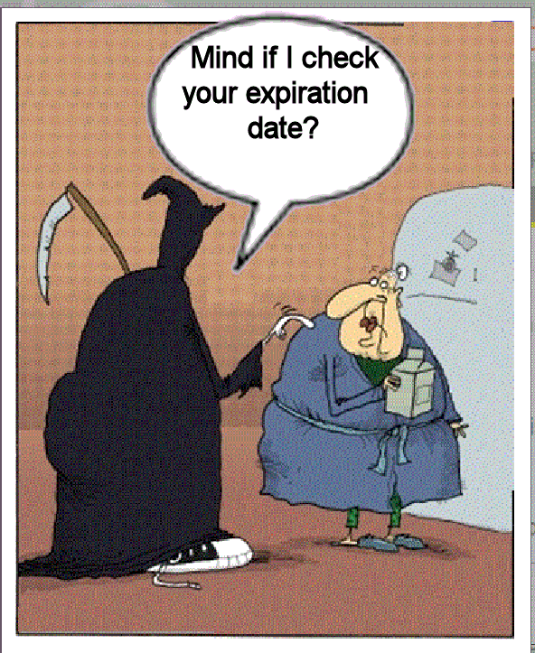
Expiration of the approval
When you have completed analysis on identifiable data and the study has an expiration date, you can close it by submitting a Request to Close
IRB does not need to be notified about closures of exempt studies
Do not allow the approval of a study to expire! If you need to continue your research or analysis on identifiable data, then submit a Request to Renew before expiration.

Slide 43
Collaboration with other researchers
Only people affiliated with Yale and listed on the approved protocol can be engaged in the conduct of Yale study UNLESS they get approval from their IRB or we sign appropriate agreements (e.g., unaffiliated investigator agreement or IRB Authorization Agreement).

Slide 44
Unaffiliated Investigator Agreements
Request for an Unaffiliated Investigator Agreement
CV
Human Subject Protection Training
HIPAA training
A letter of support from the agency

Slide 45
New Website
New System
HSC Satellite office at 238 Prospect (Center for Bioethics)

Slide 46
Where to get help
Contact the HRPP office by emailing hrpp@yale.edu to set up an appointment
Call the HRPP Office - (203) 785-4688
Check the website for policies, procedures, and guidance: http://www.yale.edu/hrpp/policies/index.html

