Slide 1
Use of a Short Form
For inclusion of non-English speaking participants in human subject research
* To play the presentation, click on the icon on the Status Bar below:

Slide 2
Consent Requirement
Federal regulations (45 CFR §46.116; 21 CFR 50.20) require that ‘the information that is given to the subject or the representative shall be in language understandable to the subject or the representative’.
Implications for involvement of non-English speaking subjects.

Slide 3
Consent document for non-English speaking individuals
A full consent form translated into the participant’s language
OR
A short form written consent document (45 CFR 46.117(b)(2) and 21 CFR 50.27(b)(2)) along with a written summary of what is presented

Slide 4
Short form – requirements
Short form document written in the language of the subject
Summary of the research study
An interpreter
A witness
Signatures

Slide 5
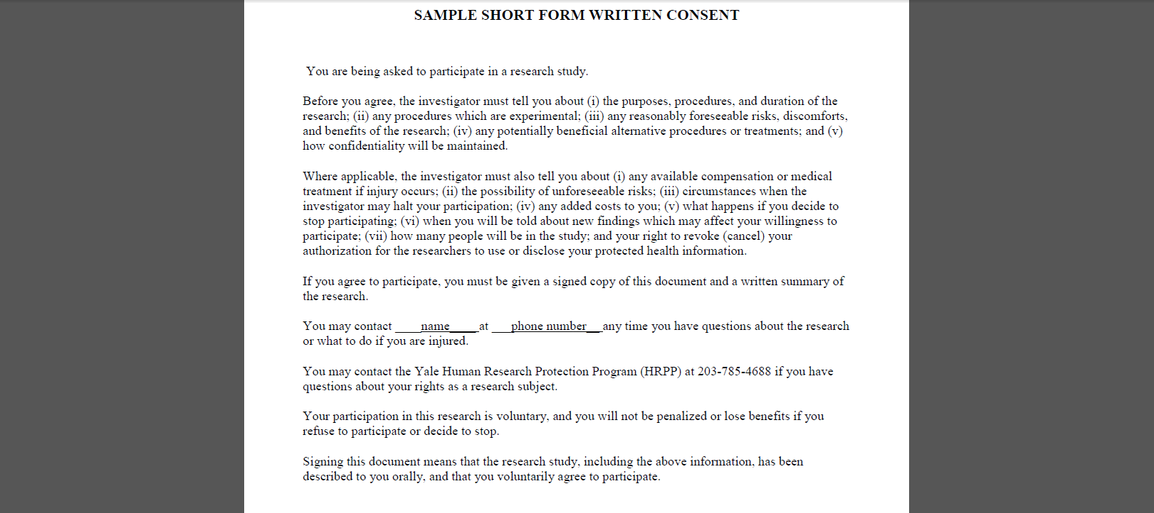
Short Form
States that the elements of informed consent have been presented orally to the subject

Slide 6
Short Form
Must be written in the subject’s language
Several translated versions are available on the HRPP website

Slide 7
Short Form
Requires a written summary of what is to be said to the subject
The IRB approved English consent document can serve as the summary

Slide 8
Short Form
Requires a witness to the consent process
A person fluent in both languages, including a family member or the interpreter, can serve as a witness

Slide 9
Who can serve as the interpreter?
Staff fluent in both languages who can consent the subject
Staff fluent in both languages who can translate the presentation
Professional translator
Important! If the study involves subjects at Yale New Haven Hospital, individuals who are to serve as interpreters must be approved by the YNHH Interpreter Services

Slide 10
Family members
A family member CANNOT serve as the interpreter
A family member CAN serve as a witness

Slide 11
Signatures
Individual
Document
Subject
Consenting Individual
Witness
Short form
Summary/full consent document
Both forms

Slide 12
Copies
The subject receives copies of both forms (short consent form/full English consent form)
The researcher keeps the signed short form and full consent form
Witness does not receive any documents

Slide 13
HIPAA
If the full consent form includes HIPAA elements, then the IRB needs to waive the requirement for a signed authorization
If there is a separate translated HIPAA RAF, subjects can sign that form

Slide 14
Summary
The inclusion of non-English speaking participants and the use of the short form must be described in the protocol and approved by the IRB

Slide 15
Summary
Short form is to be used when non-English speaking subjects are unexpectedly encountered

Slide 16
Summary
If the short form in the language of the participant is listed on the HRPP website, it does not have to be submitted for review and approval
OTHERWISE
The short form translated into the language of the subject must be approved by the IRB

Slide 17
Summary
There must be a qualified interpreter
NOT a family member

Slide 18
Summary
There must be a witness fluent in both languages to the verbal presentation
CAN be a family member or the interpreter

Slide 19
Summary
Subject signs short form but receives both
Witness signs both forms but receives none
Researcher signs full English consent form/summary and keeps both forms on file

Slide 20
Further Guidance
200 GD2: Inclusion of Non-English Speaking Participants in Human Research on HRPP website
OHRP statement on OBTAINING AND DOCUMENTING INFORMED CONSENT OF SUBJECTS WHO DO NOT SPEAK ENGLISH http://www.hhs.gov/ohrp/policy/ic-non-e.html
Email HRPP@yale.edu or call 785-4688

