Slide 1
IRES IRB Changes for Researchers and Staff
Single Site Studies under Yale IRB Purview
To begin voiceover, click on this symbol at the bottom, next to zoom function
Human Research Protection Program
Version 1.0
Effective Date: August 9, 2021

Slide 2
Training Agenda
Item | Slide #
Navigation | 4
Screen Specific Updates | 13
Report of New Information | 24
First action on protocols after the upgrade | 27
https://mpclkyalestage6.huronclick.com/Training

Slide 3
Overall changes
Change Type | Summary
Navigation | Dashboard vs. My Inbox Shortcuts to Library, Help Center, IRB Submissions, IRB Reports moved from Menu to top screen Consolidated ‘Create New Study’ and ‘Create RNI’ Revised feel and look Added menu for screens to study level navigation
Screens | Added/removed questions on screens Enhanced Yale specific pages
Process | For multi-site research under Yale IRB purview Majority of changes relate to internal IRB/HRPP operations with no impact to the research community

Slide 4
Navigation

Slide 5
My Inbox = Dashboard
Inbox

Slide 6
IRB Navigation
New

Slide 7
Study Workspace

Slide 8
Final IRB Determinations

Slide 9
Navigation – CR/MOD/MODCR
Clicking on the two arrows sign in MOD or CR workspace will show the breadcrumb to take you back to main study

Slide 10
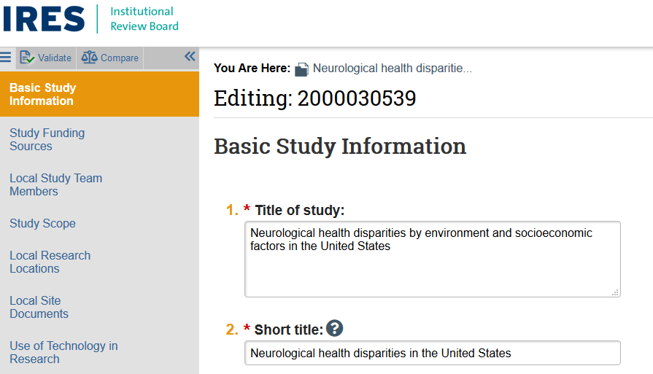
Study Navigation – ‘Edit Study’
No ‘Jump to’ button, instead, the study pages appear on the left

Slide 11
Page Navigation

Slide 12
Screen Changes

Slide 13
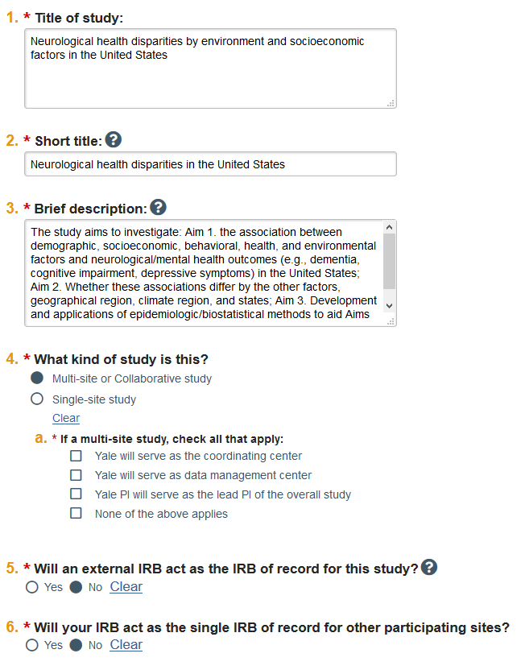
Basic Information
REVISIONS
Removed question # 7 Added question about type of study (#4) Added question whether Yale will serve as IRB of Record for other sites (#6) (if question 4 indicates Multi-site research), Minor wording changes in questions

Slide 14
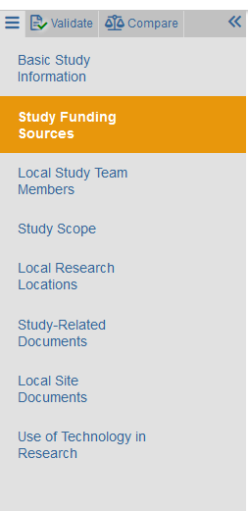
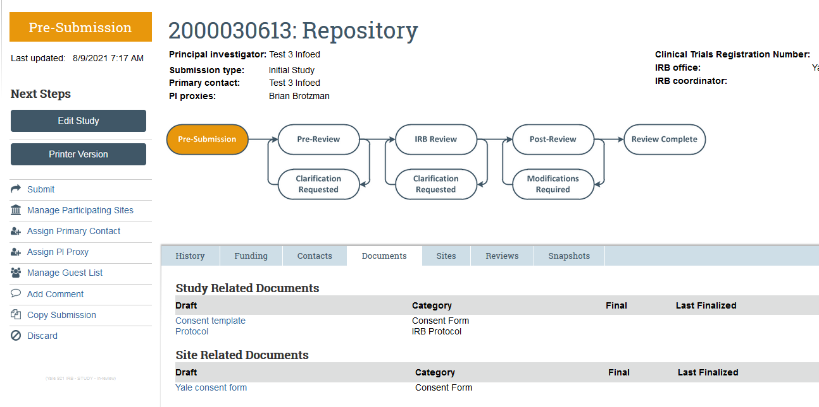
Study vs. local documents for multisite research

Slide 15
Adding sites with Yale as the IRB of Record
Contact the HRPP Office for guidance before adding sites .

Slide 16
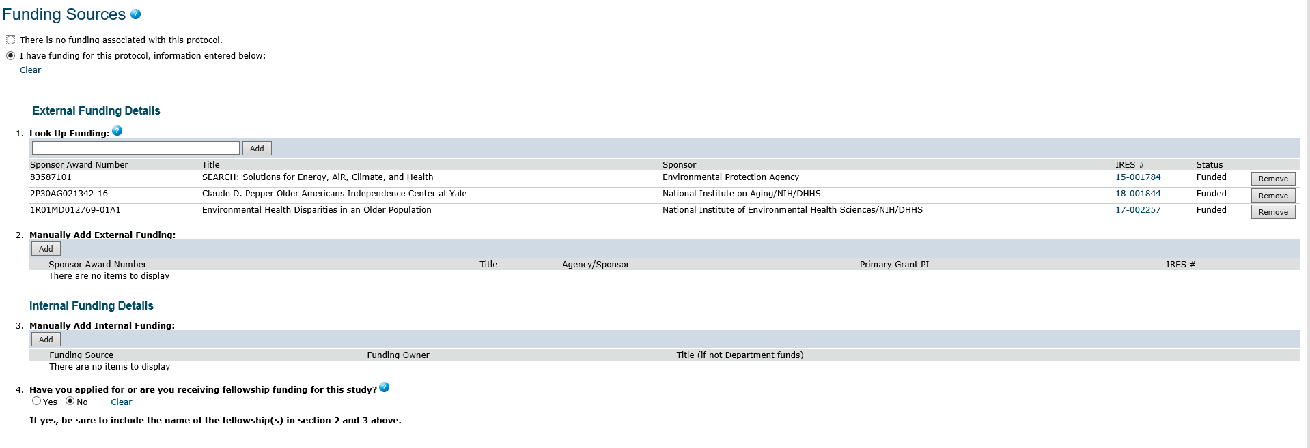
Funding Source
REVISIONS
Removed question # 4

Slide 17
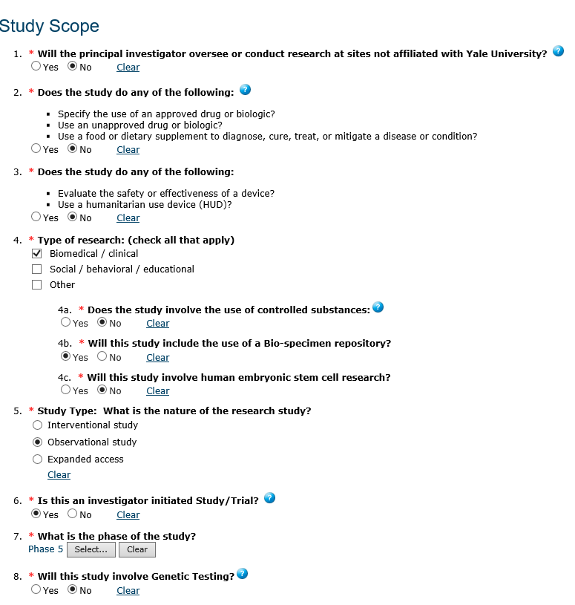
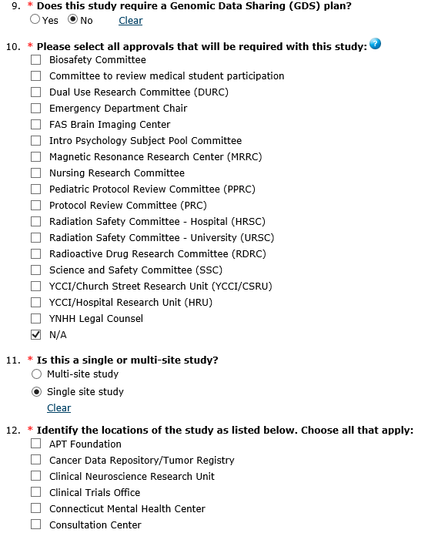
Study Scope: Questions Removed

Slide 18
Study Scope: Questions Added

Slide 19
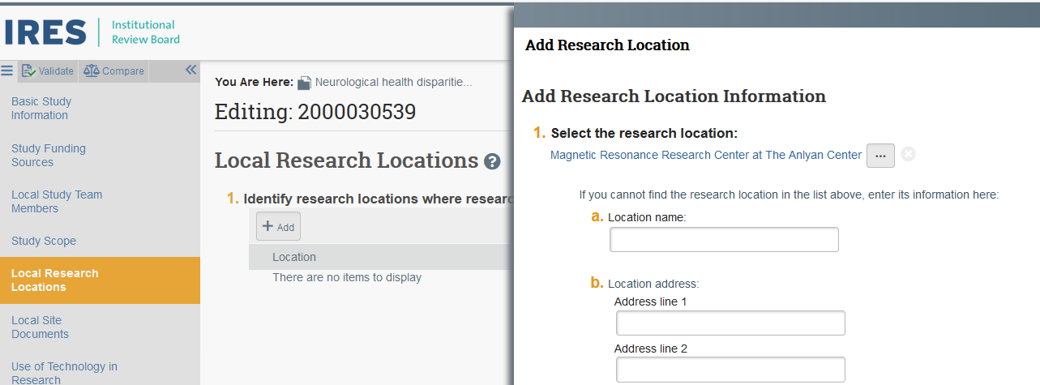
Local Research Locations
Many pre-populated research locations at Yale available for selection, including all Smilow Hospital Care Centers

Slide 20
Consent Forms and Recruitment Materials & Supporting Documents Page
REVISIONS
Name of the screen was revised from ‘Consent Forms and Recruitment Materials ’ to ‘Local Site Documents’ Page now includes selection from Supporting Documents page

Slide 21
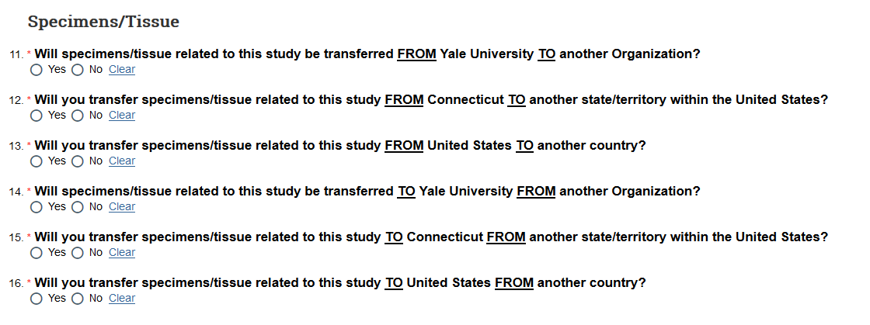
Use of Technology in Research
REVISIONS
Added section about Specimens and Tissue Minor reorganization on question on the page

Slide 22
Report of New Information (RNI)

Slide 23
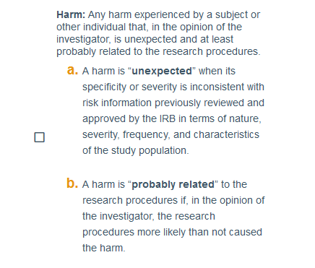
Wording of the UPIRSO category is revised
Revised Wording

Slide 24
New Categories Added

Slide 25
First Actions on Existing Protocols After Upgrade

Slide 26
‘Validate’ to view missing information
Use Validate before submitting Initial studies, Modifications, and Continuing Review with Modifications.
Continuing Reviews (without modification) will not require answering additional questions.

Slide 27
Error message if missing answers not provided

Slide 28
Verify that information is correct
Verify that locations in the Local Research Locations is accurate.
For existing and approved research – do not move documents (e.g., from Local Site to Study-Related Documents). We want to preserve the history of the revisions to these documents.

Slide 29
First action on protocols after the upgrade
IRB will ask for missing information for submissions in Pre-Review Status via:
Clarifications Requested on MODs, MODCRs, Initials
IRB will ask for missing information for submissions in Committee Review Status via:
Modifications Required on MODs, MODCR, Initials
Deferred
No changes during reviews of CR

Slide 30
Questions
Contact IRB Support: irb.support@yale.edu
Contact HRPP : hrpp@yale.edu

